Slide 1
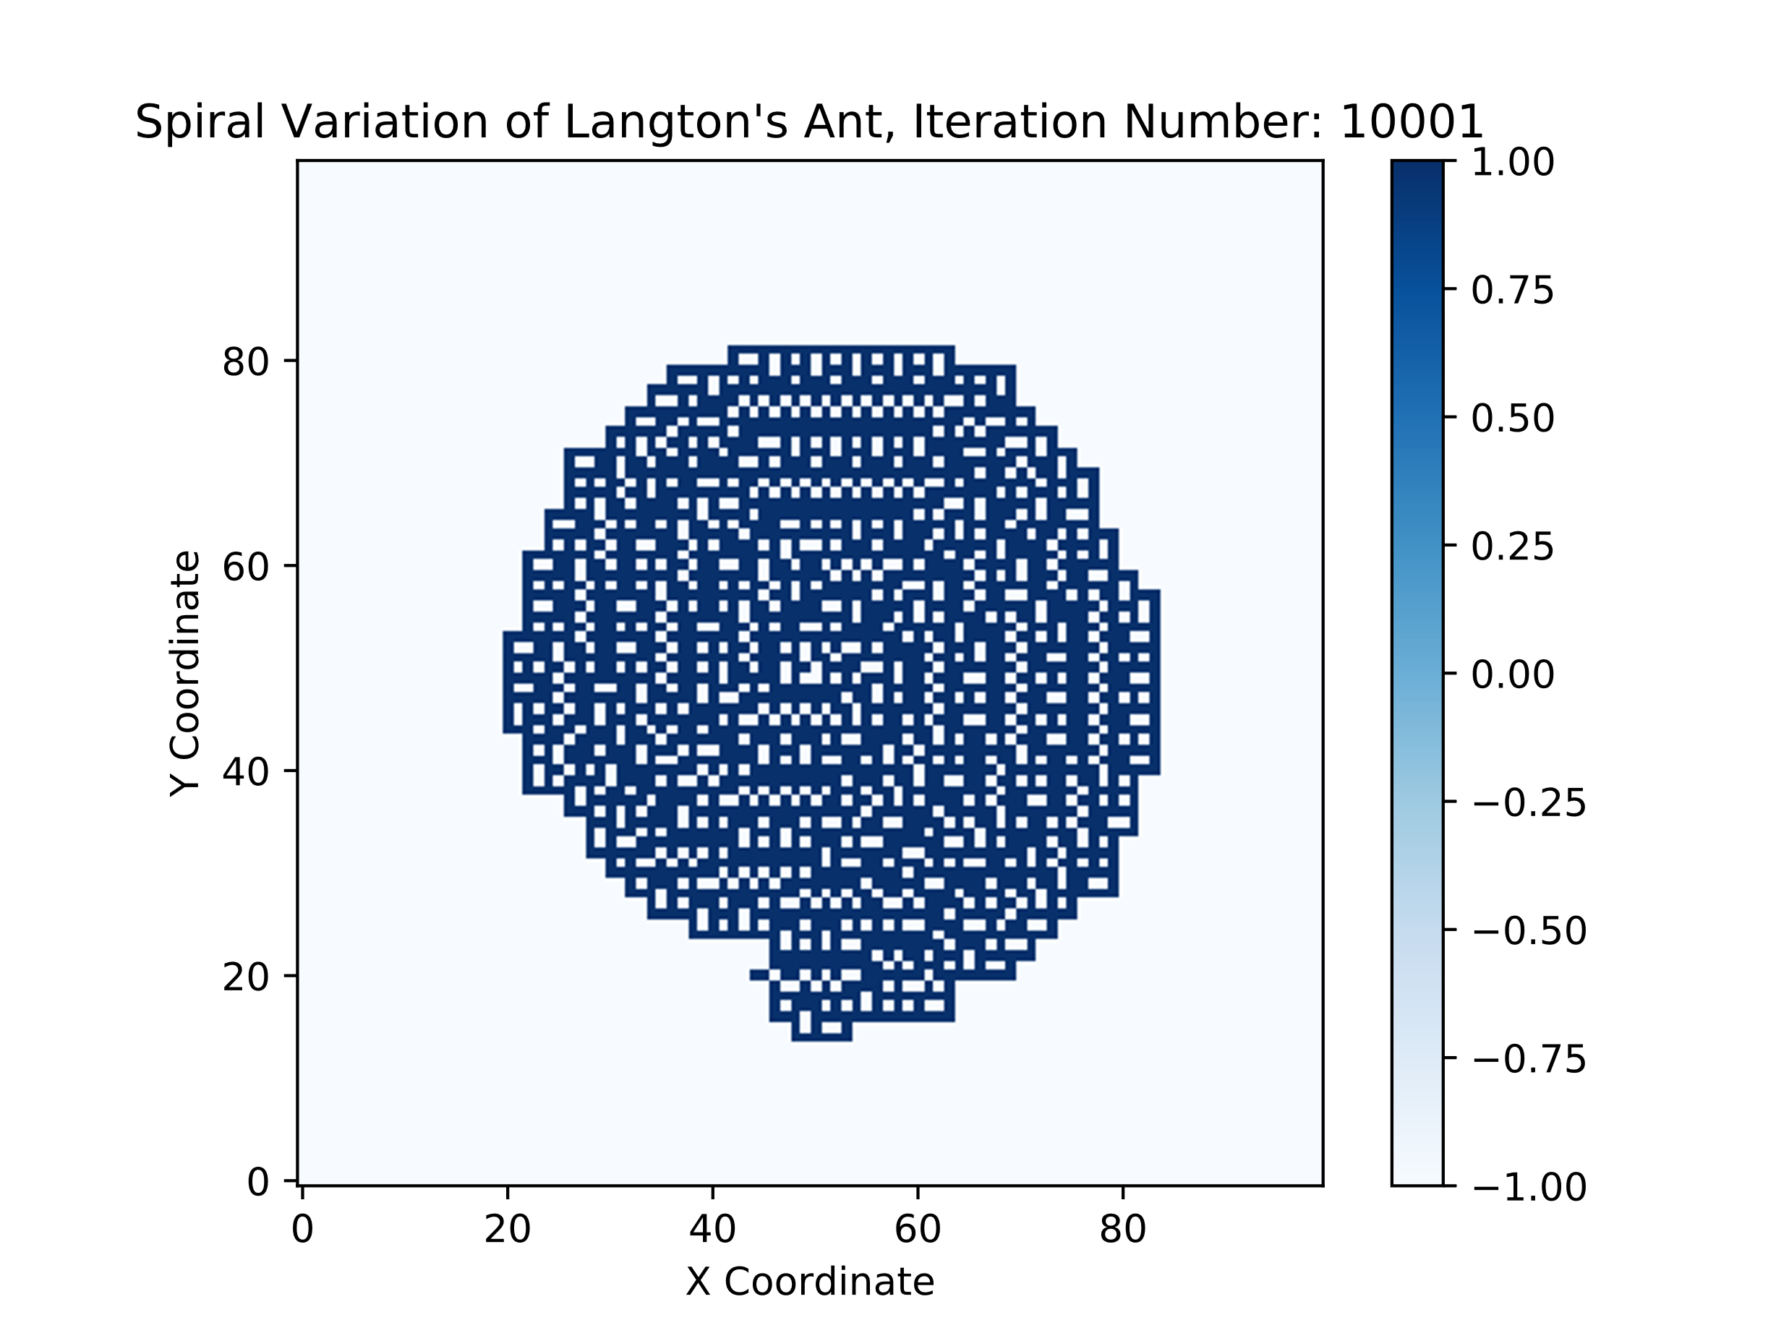
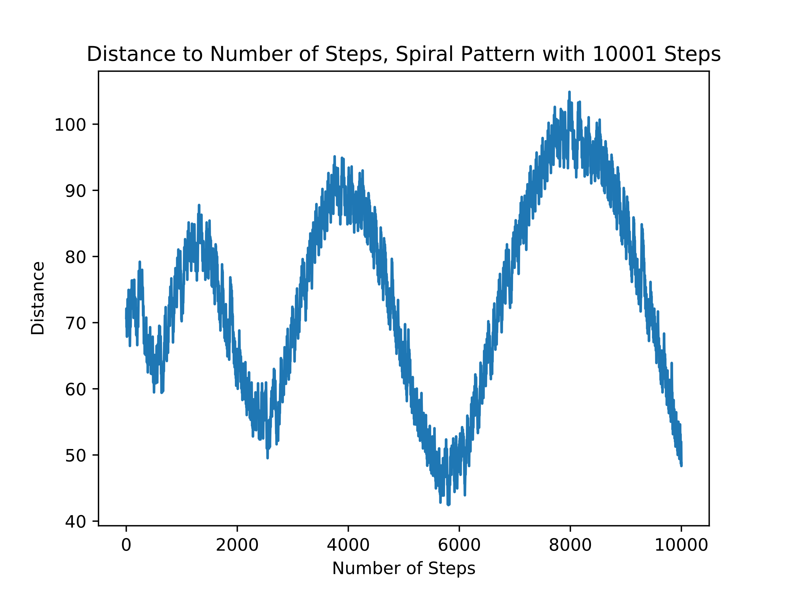
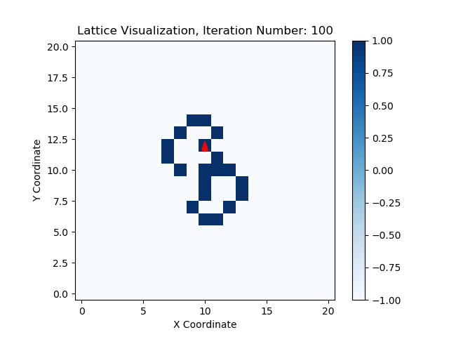
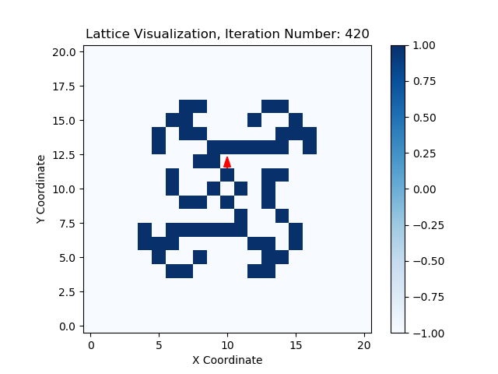
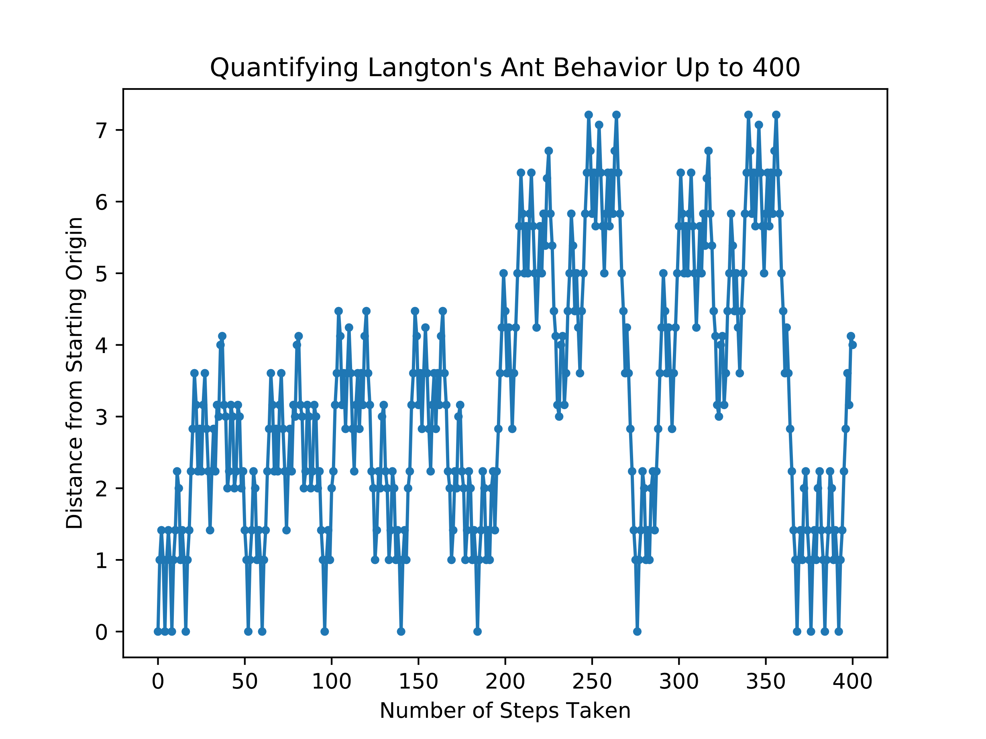
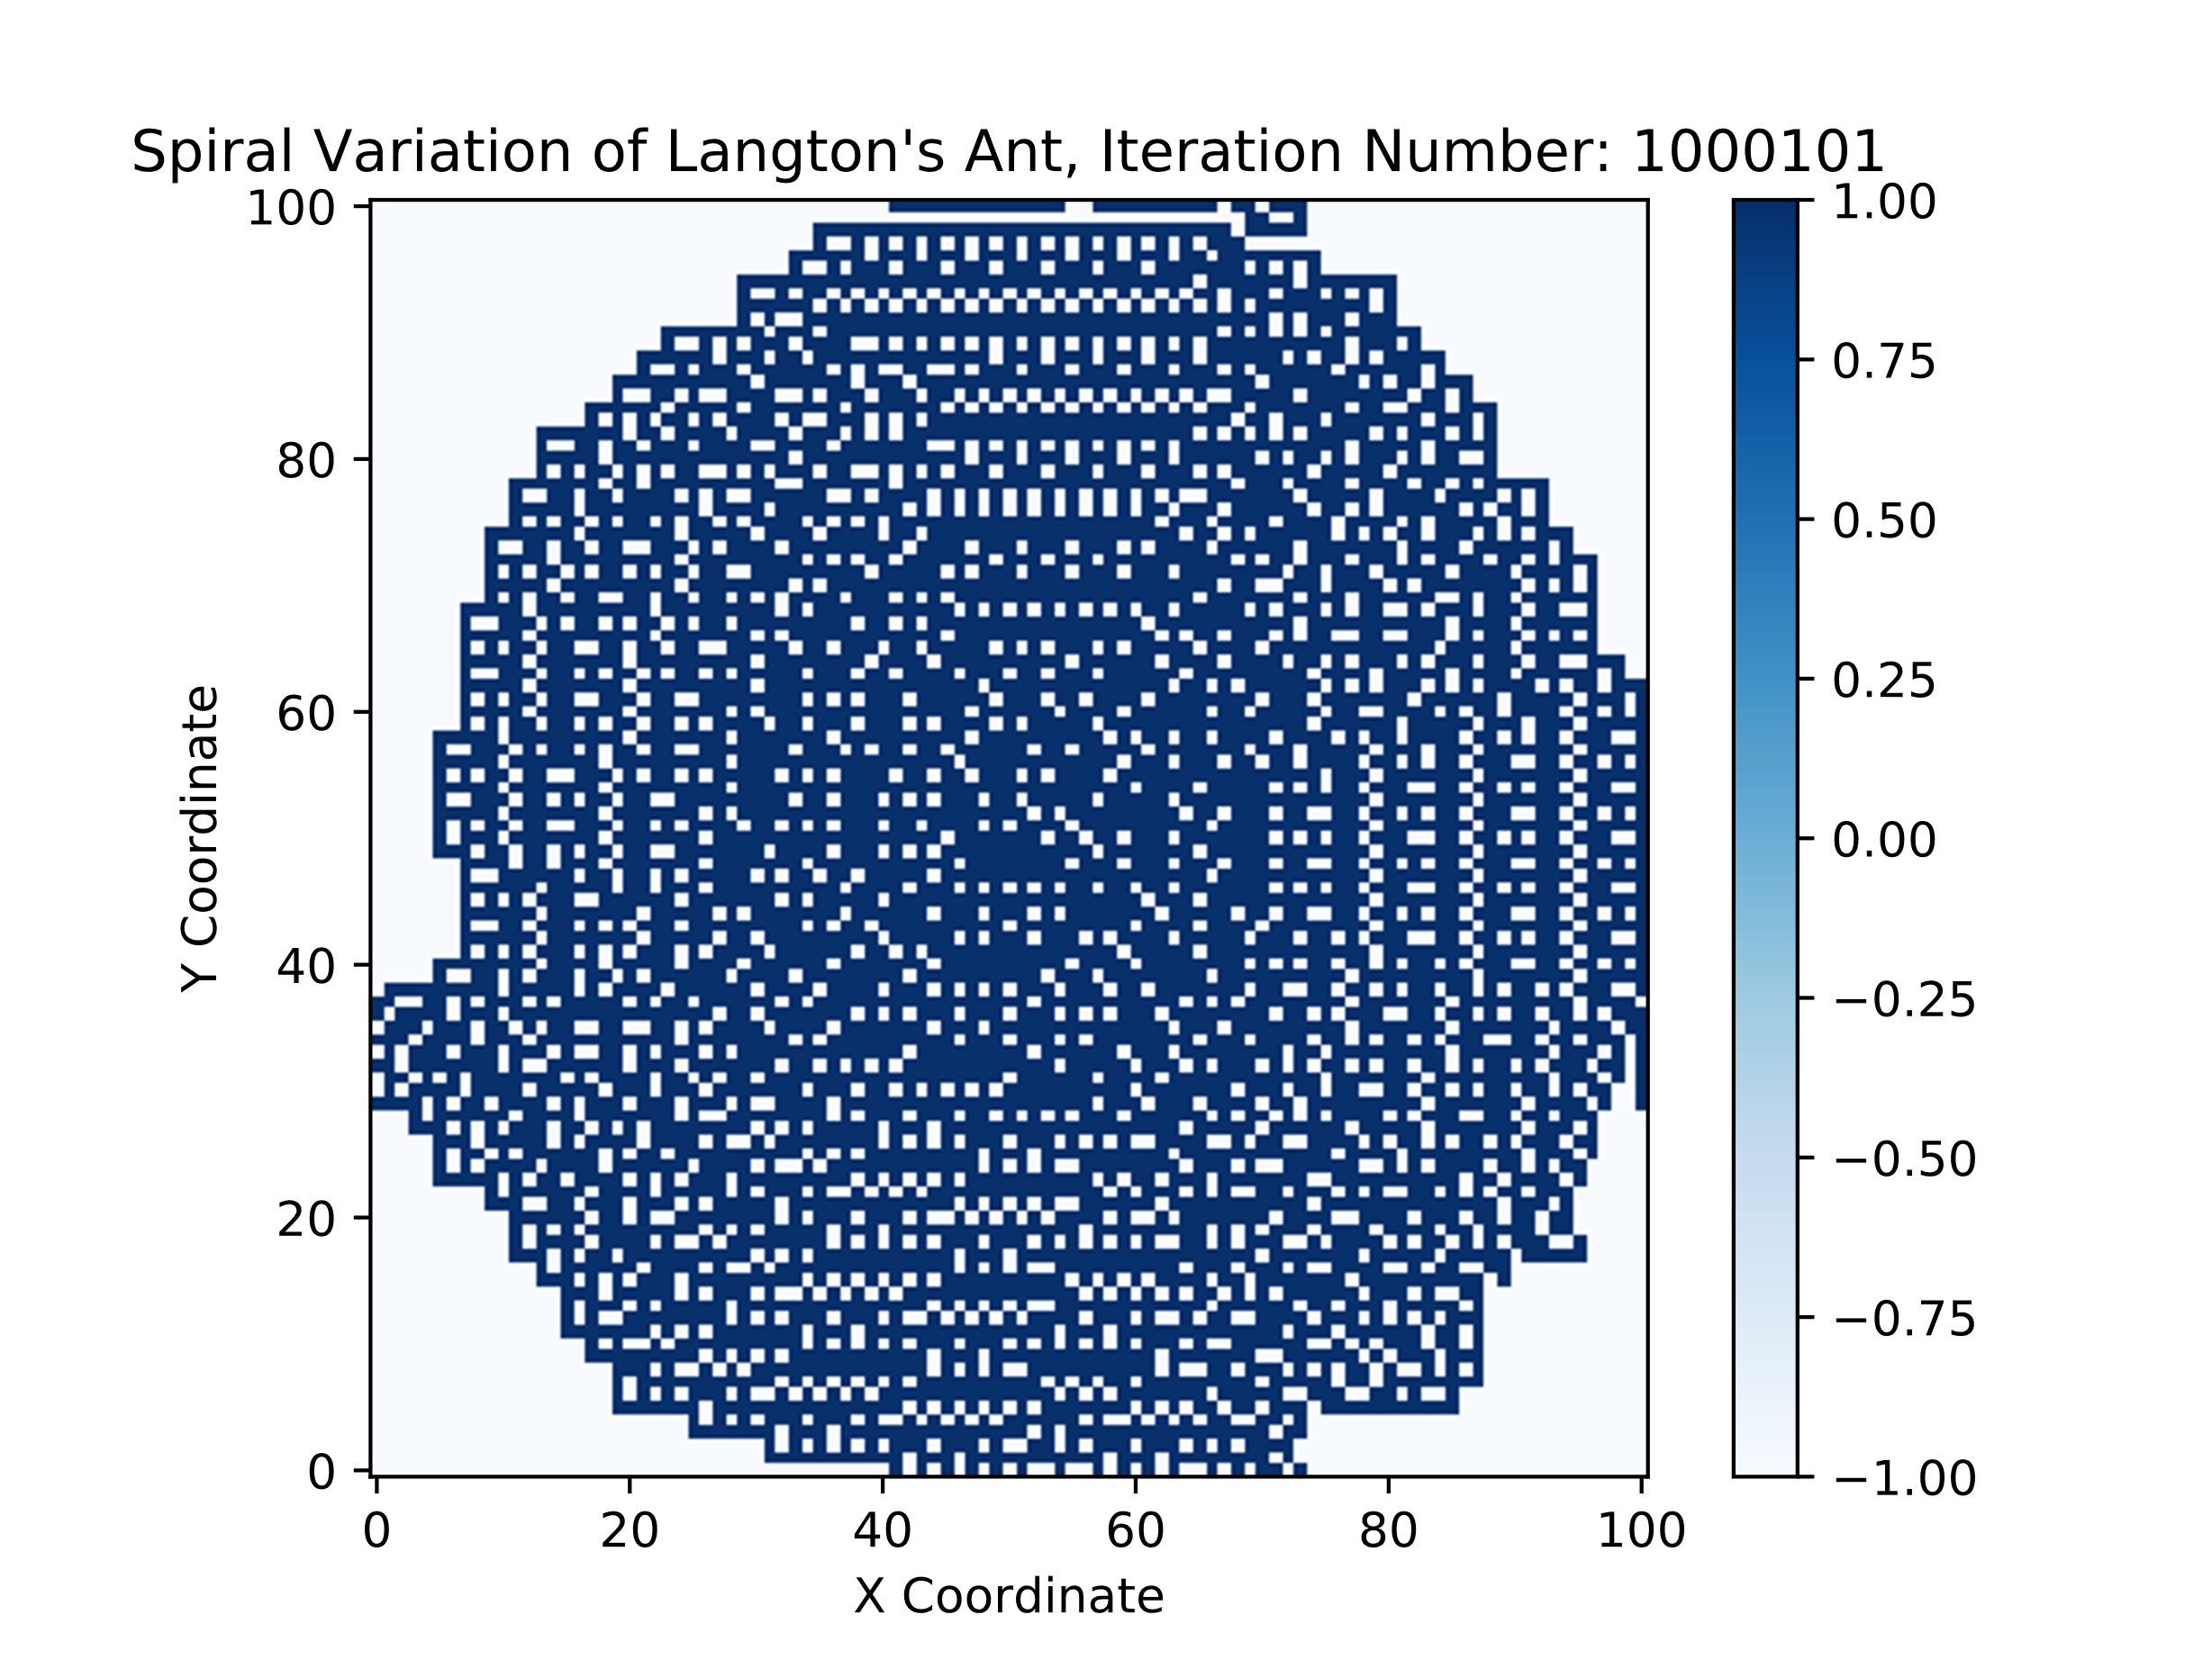
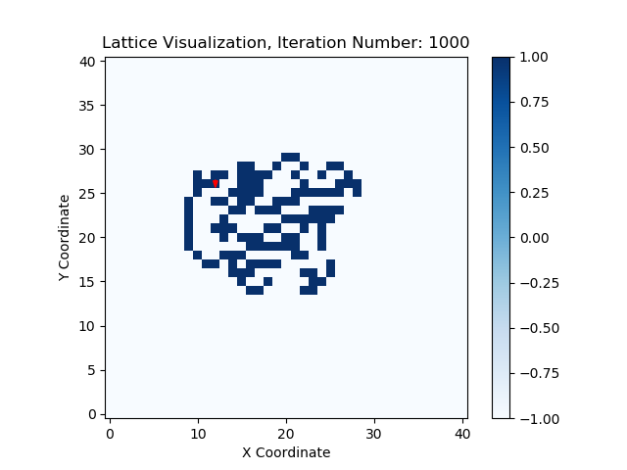
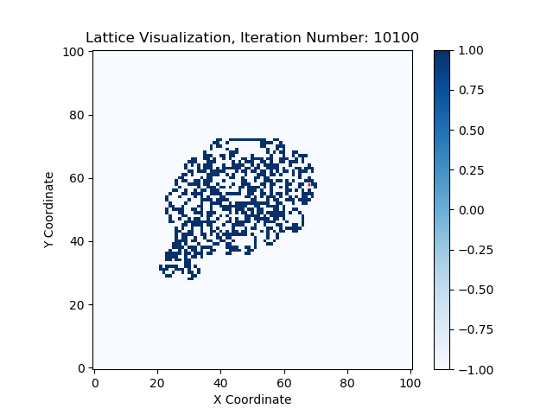
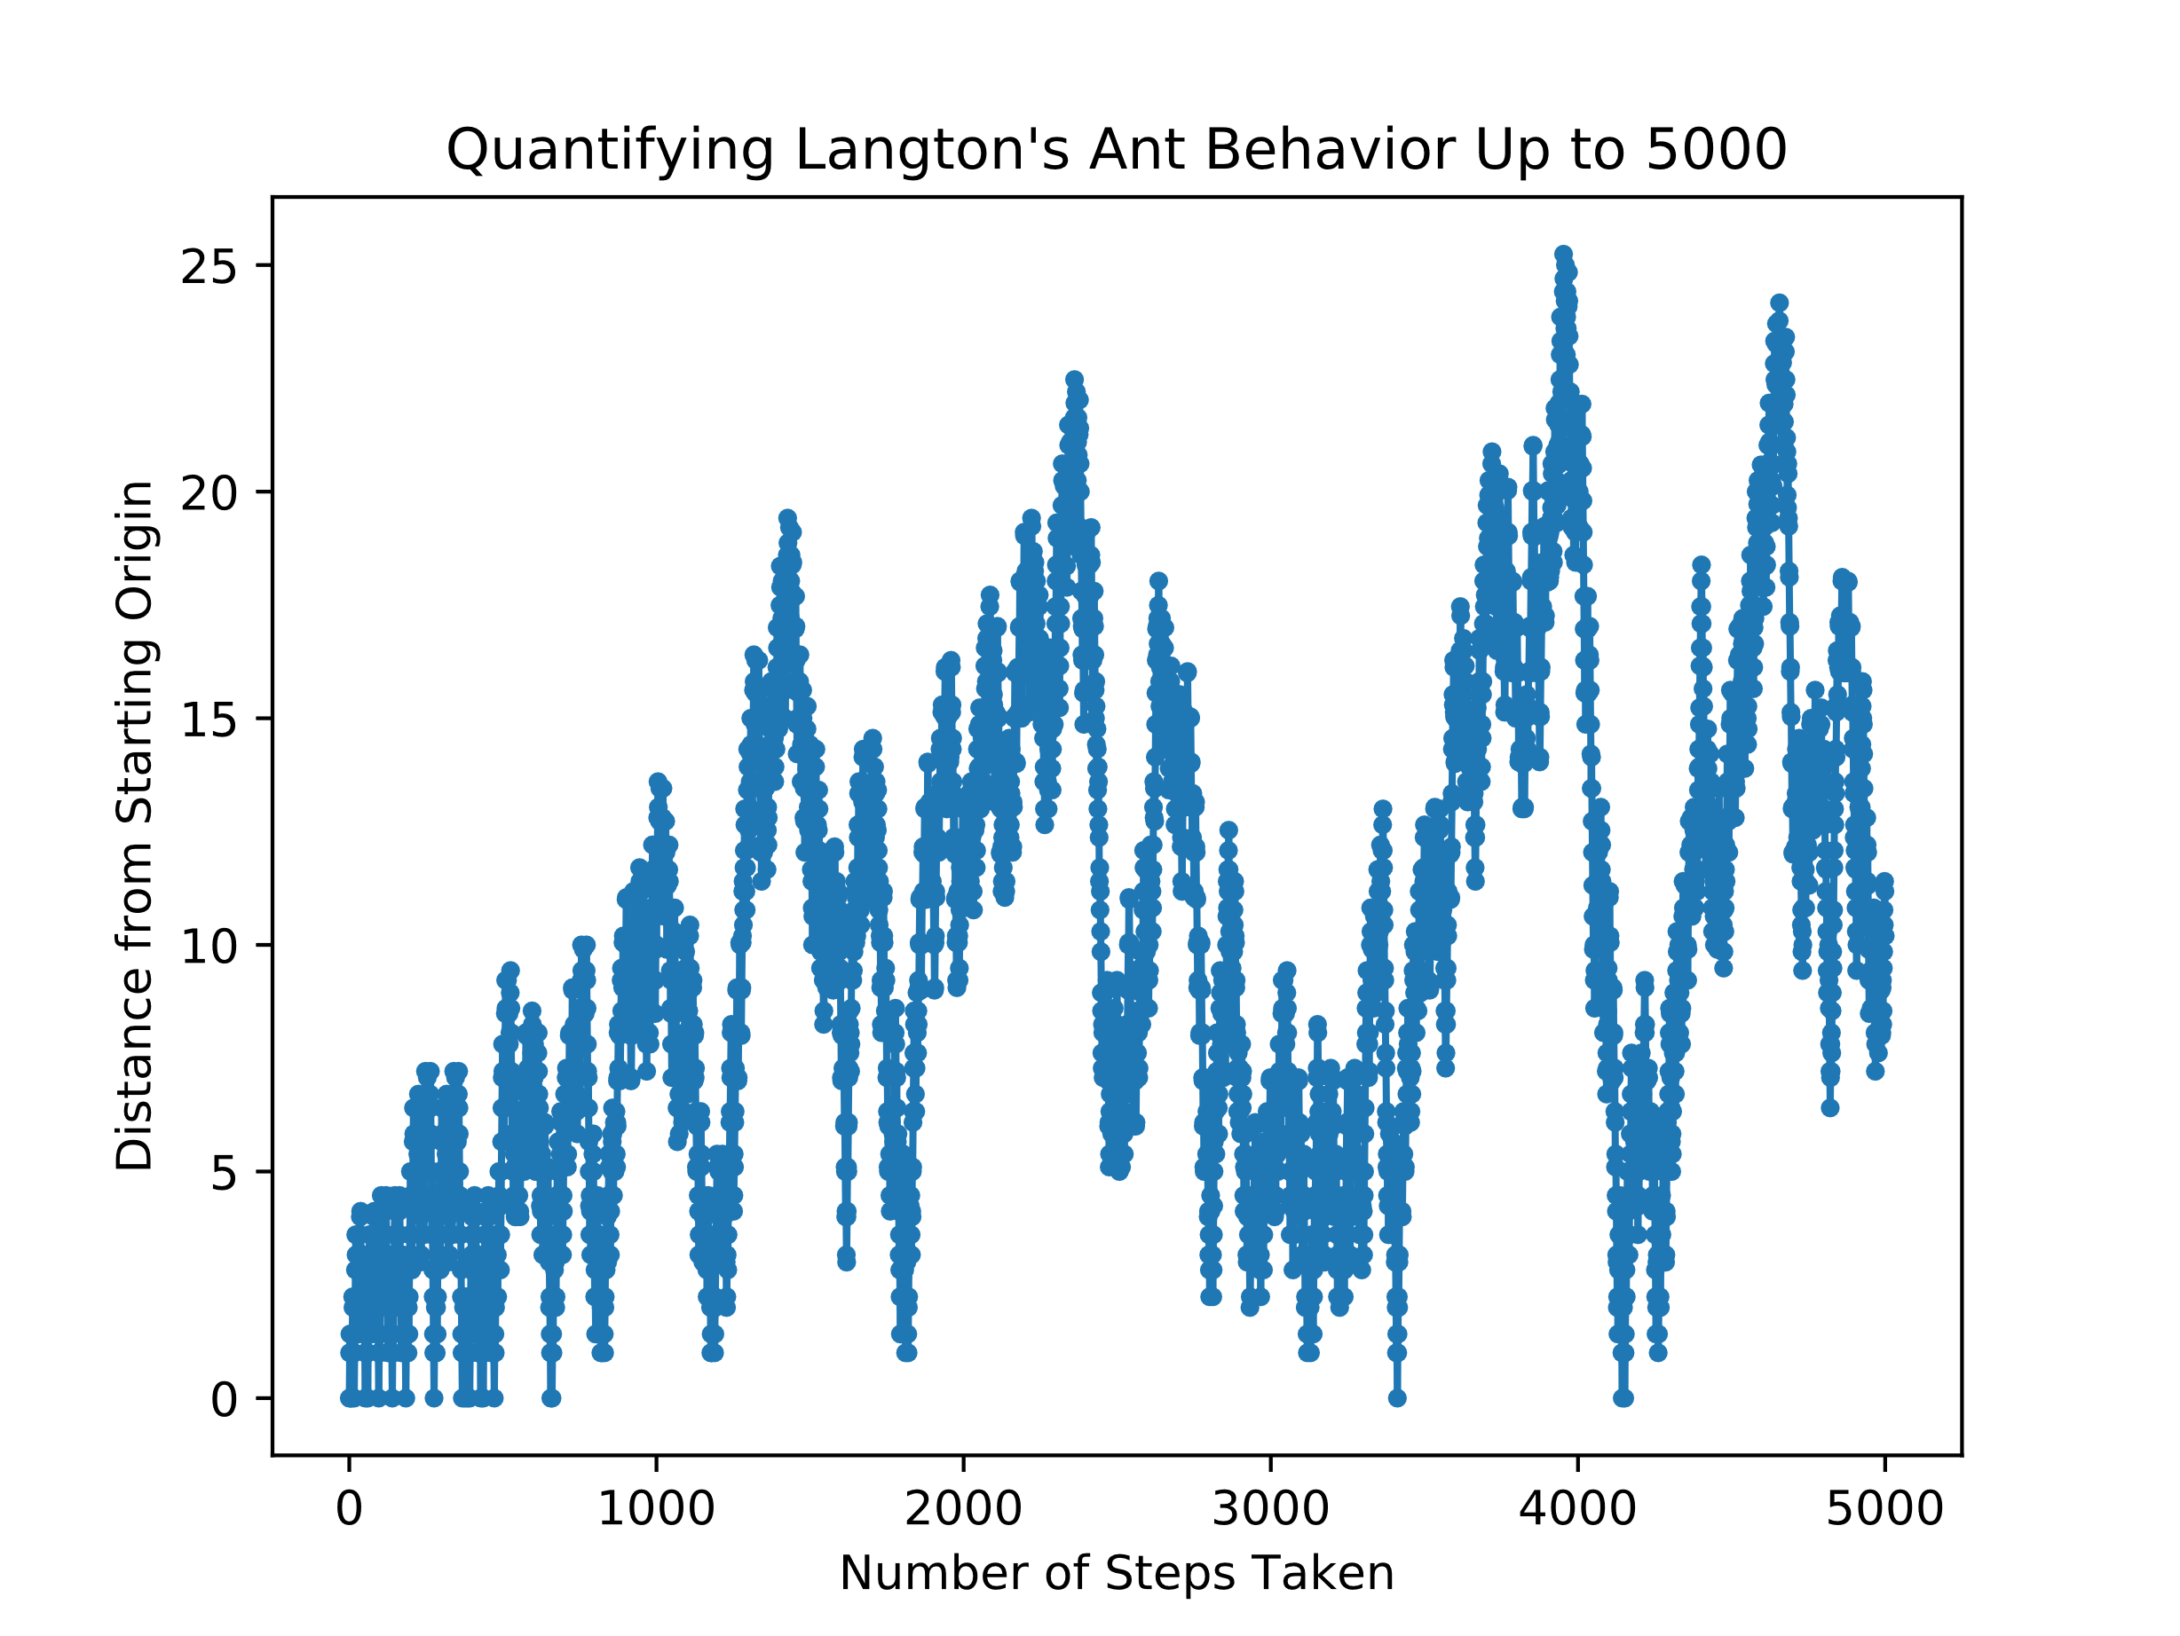
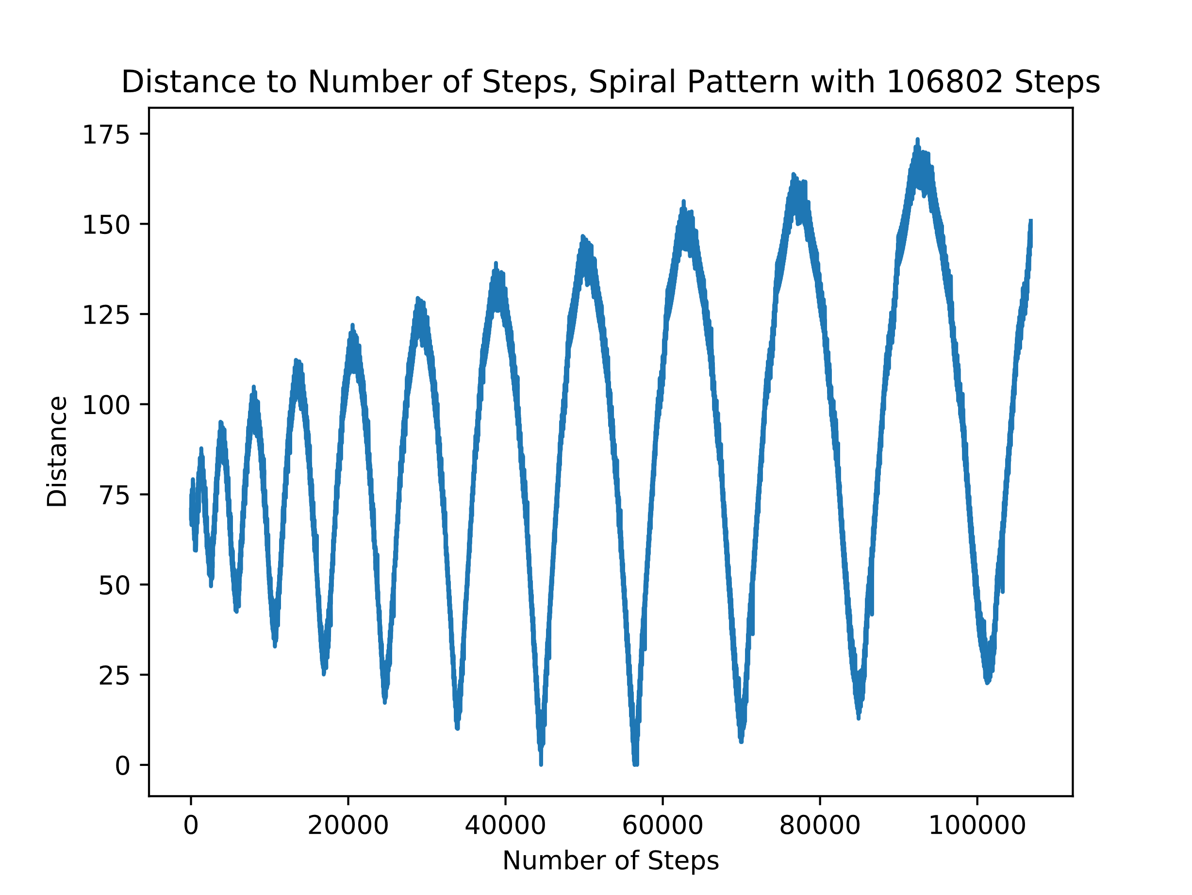
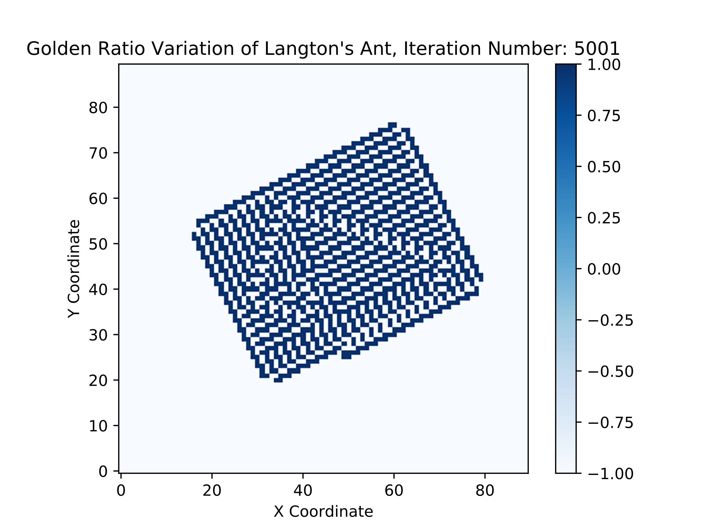
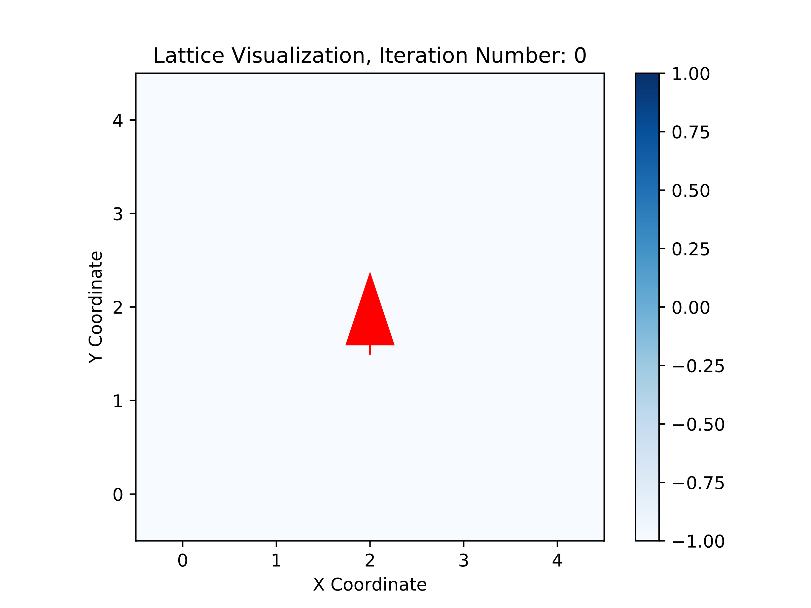
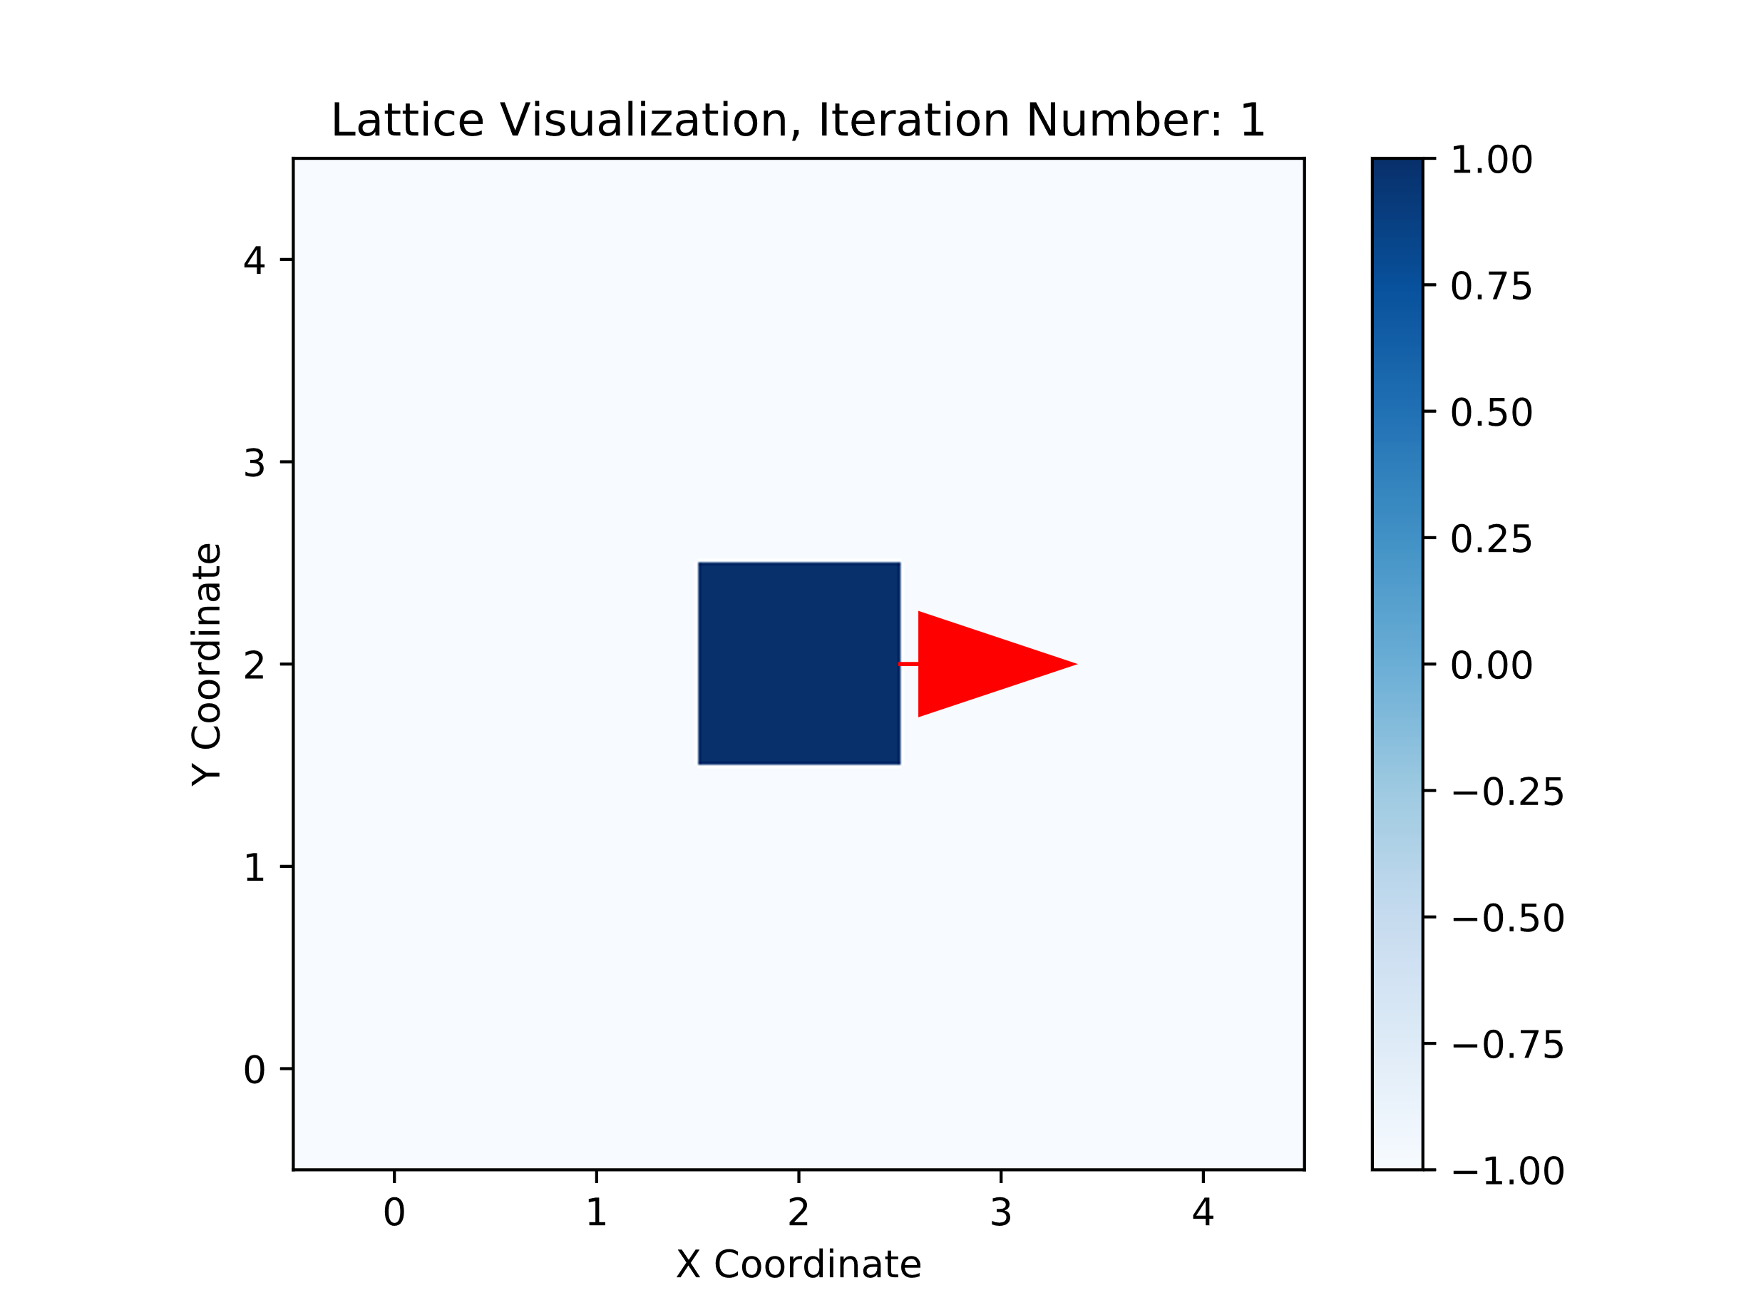
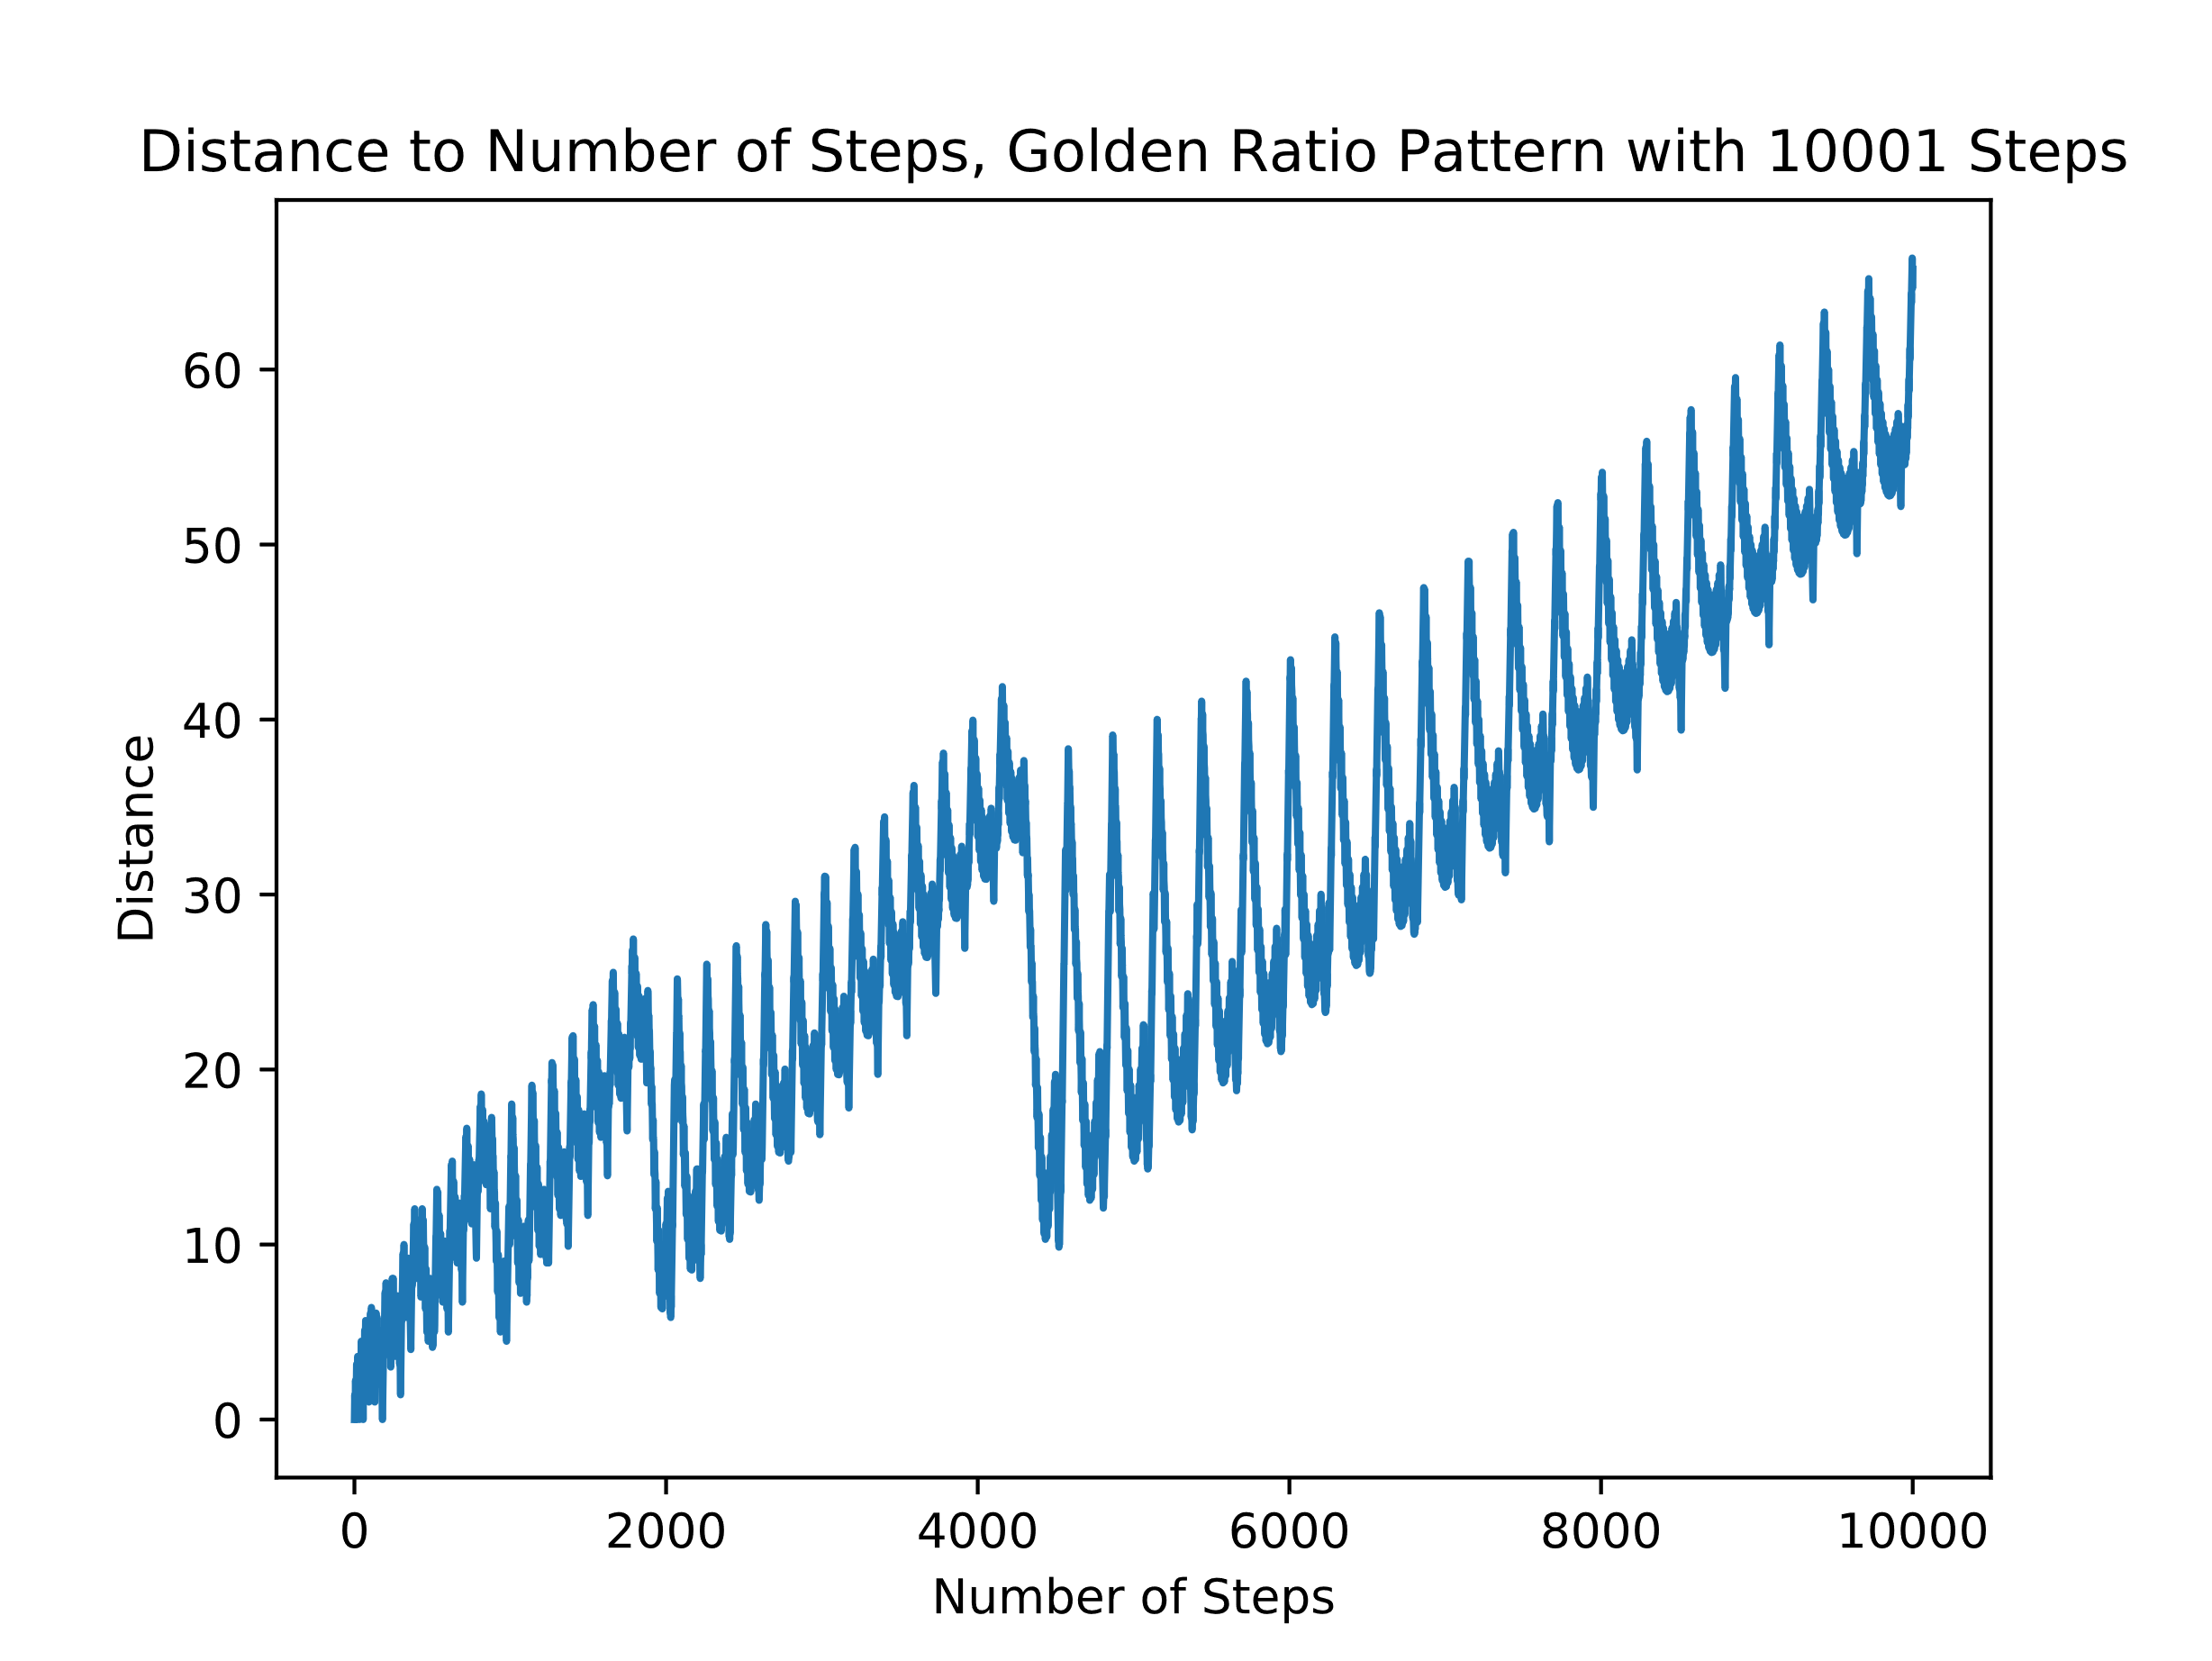
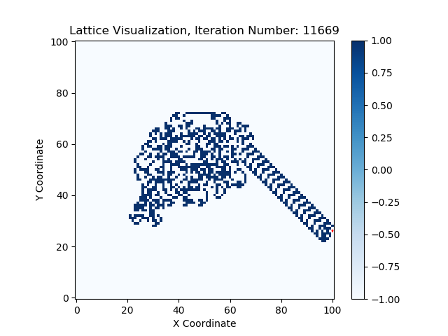
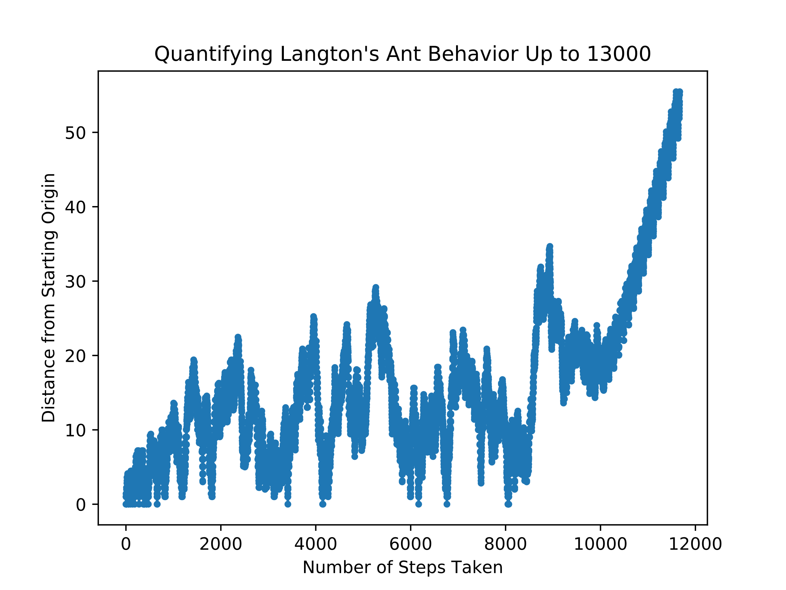
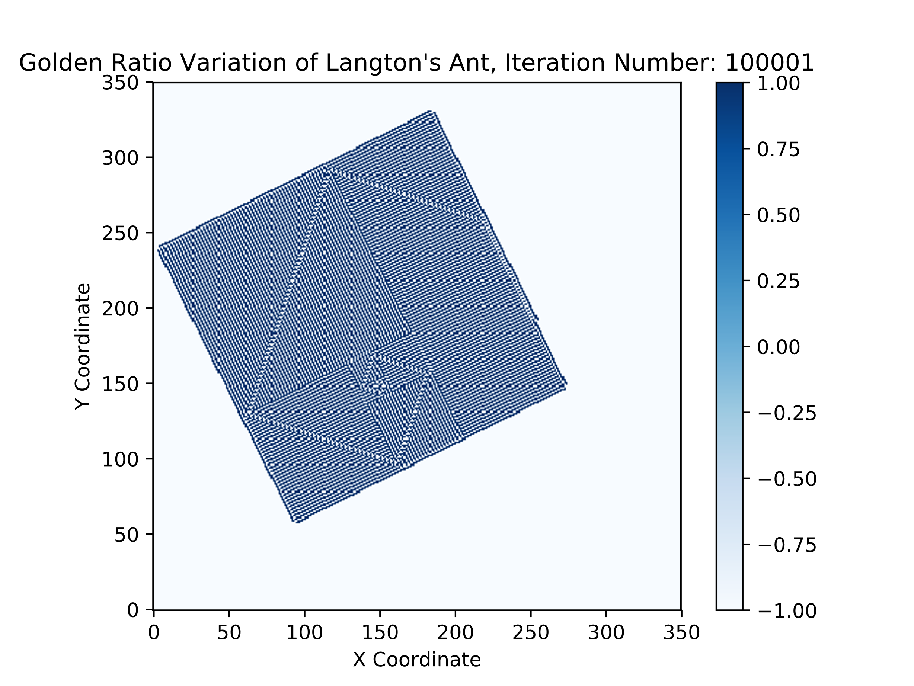
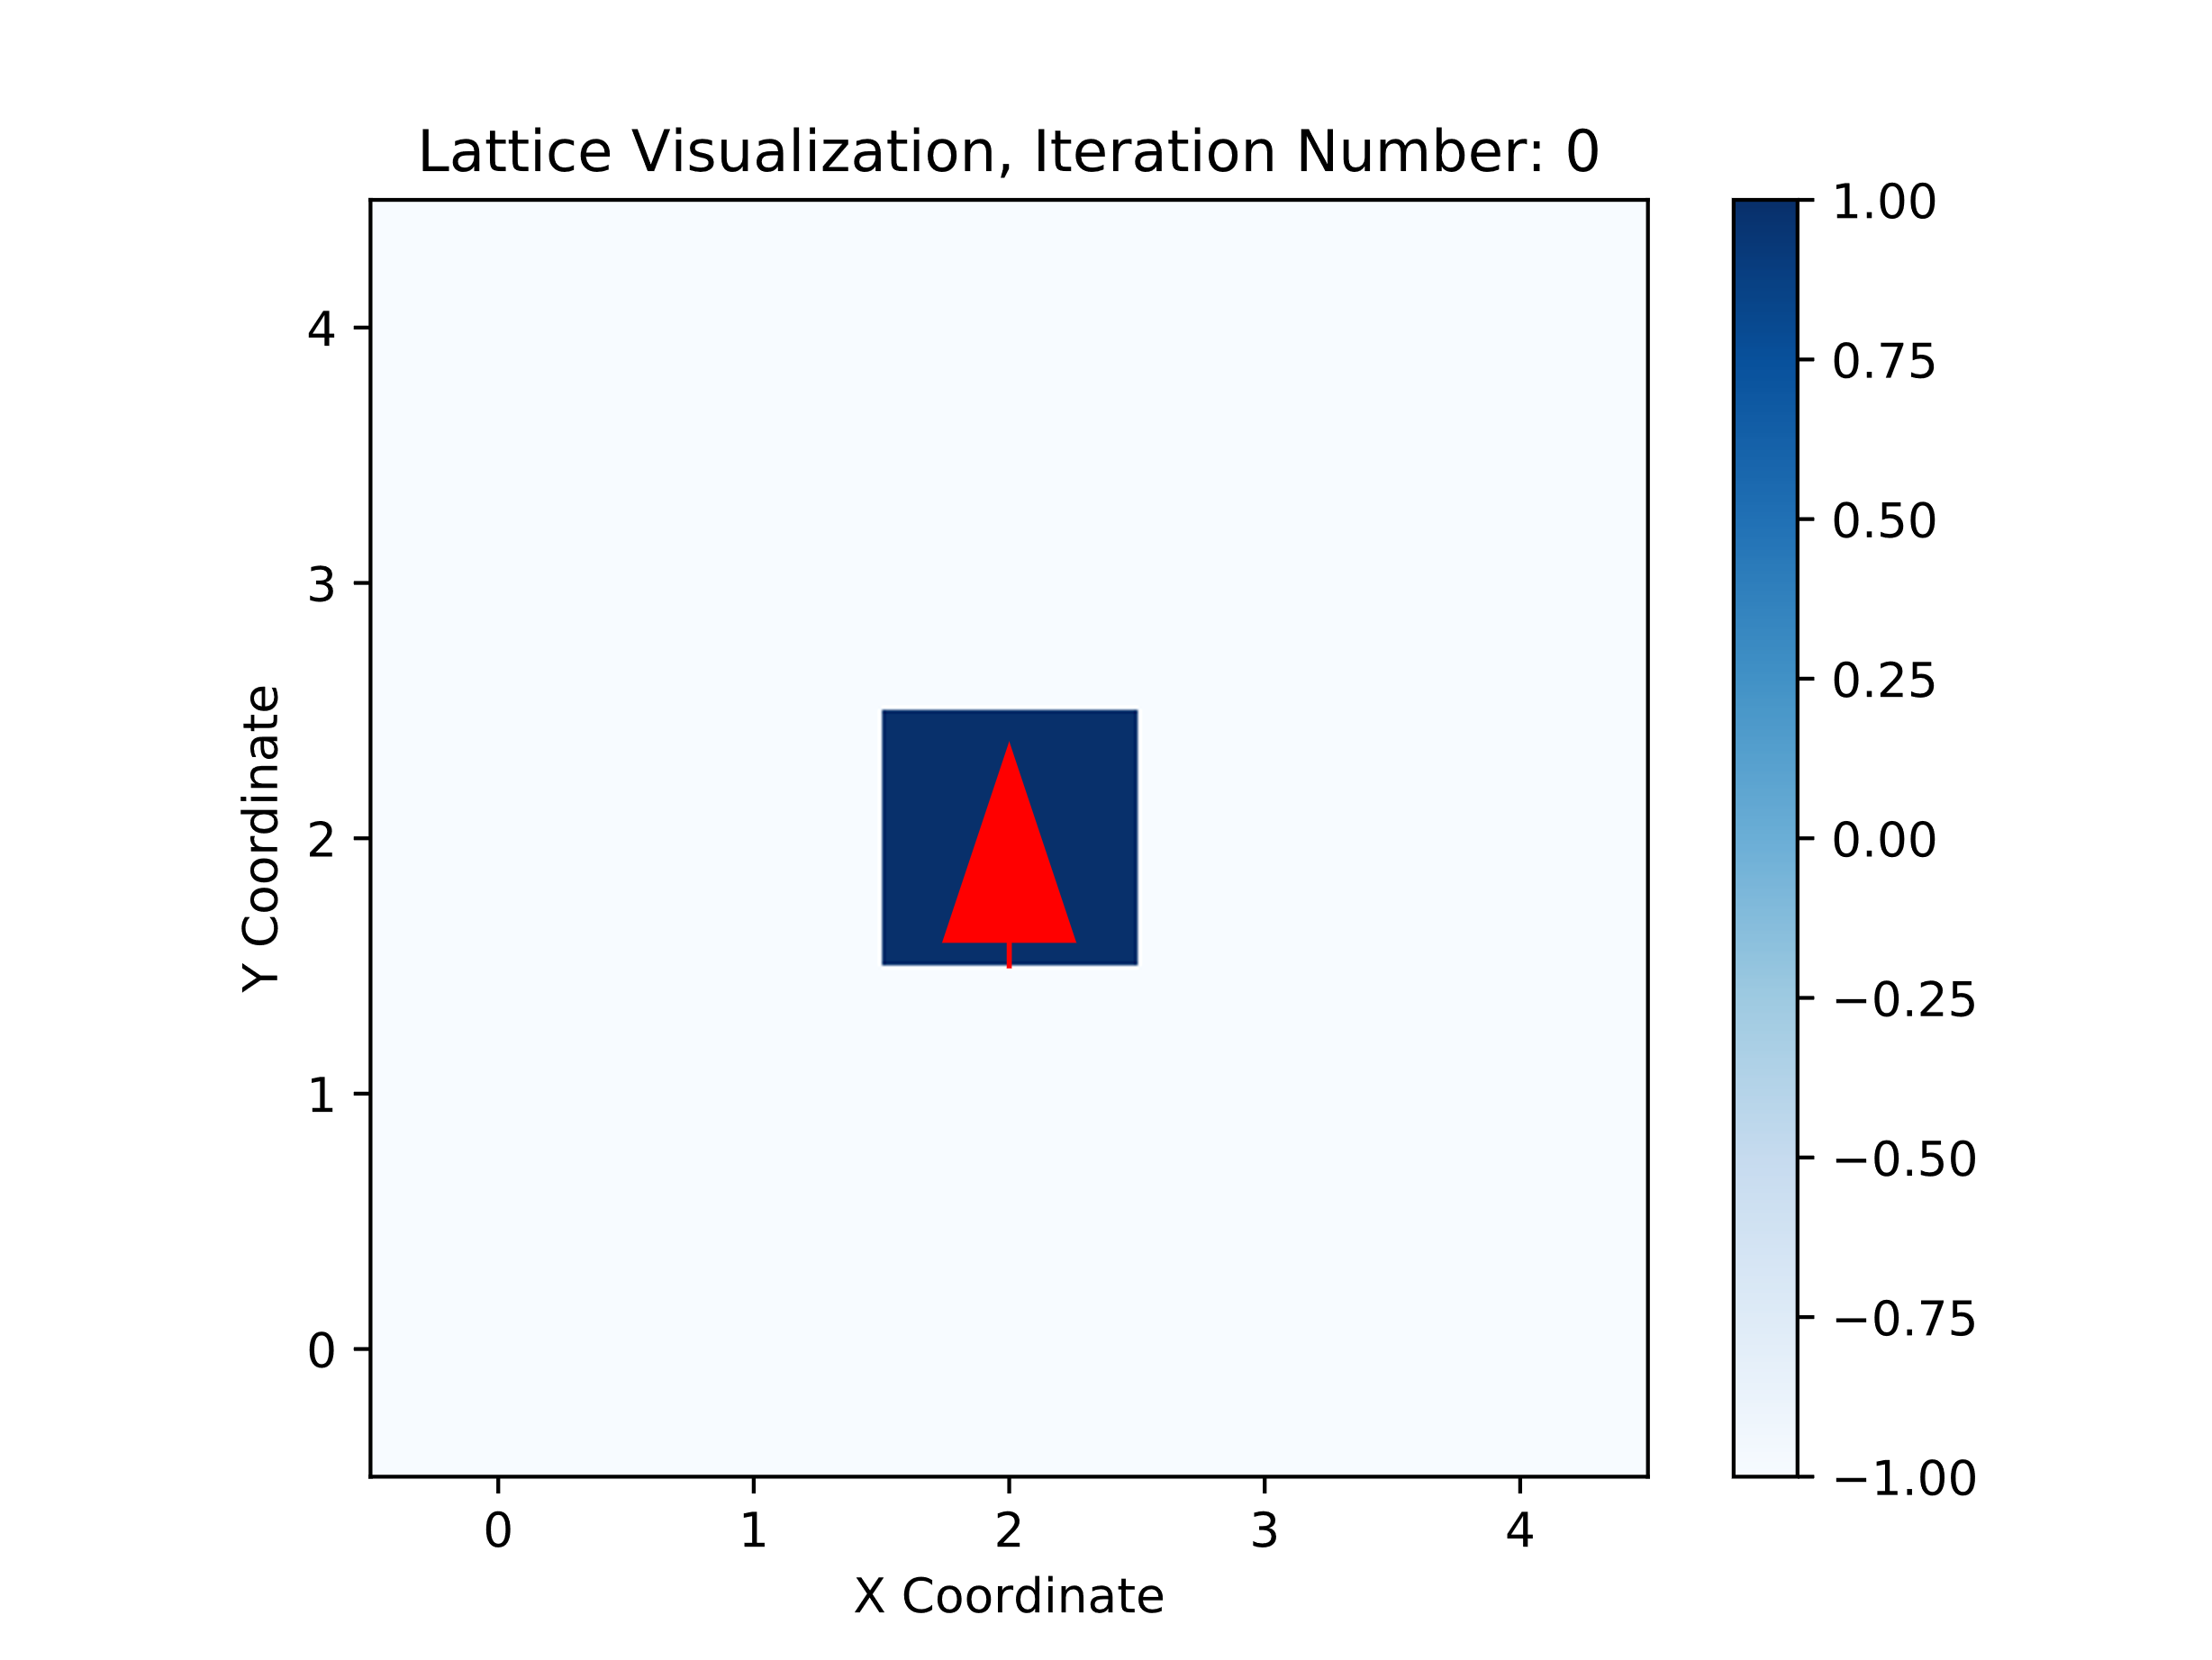
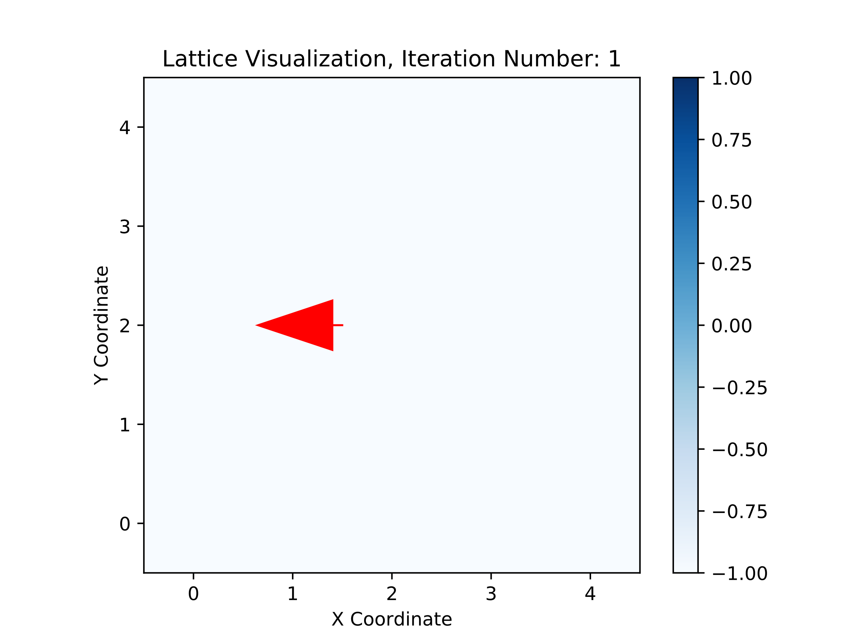
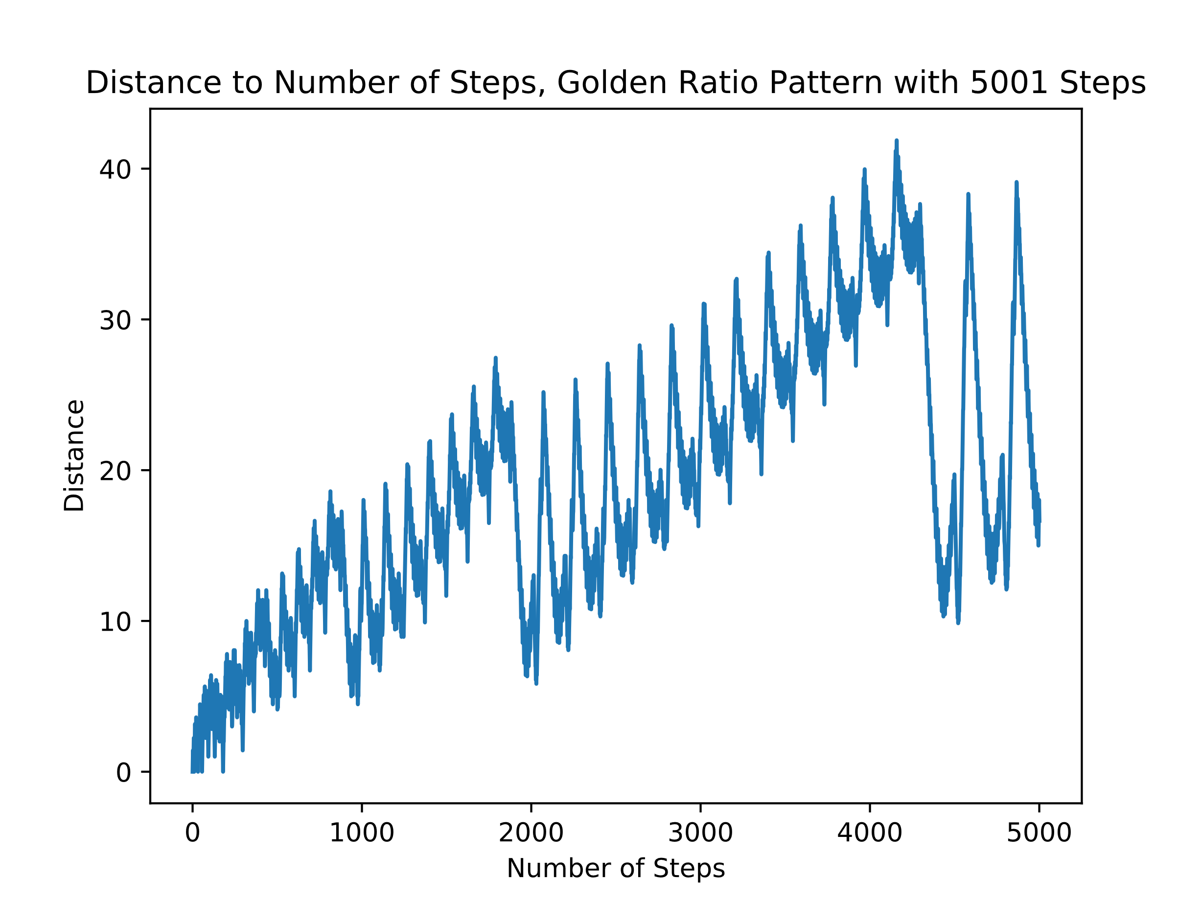
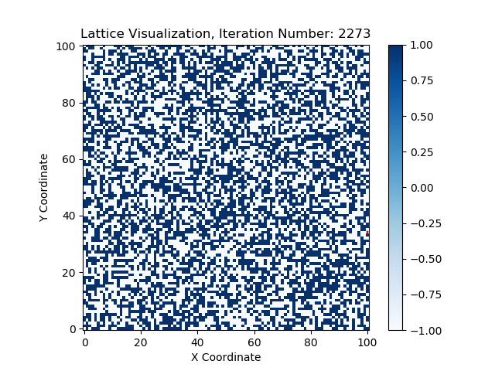
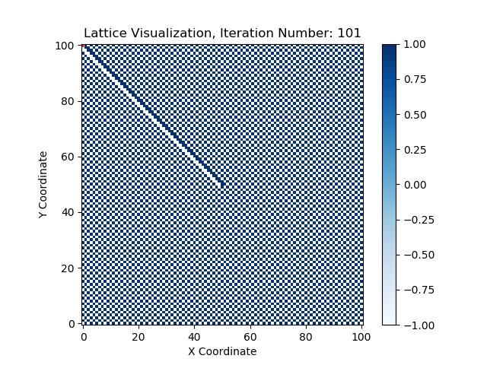
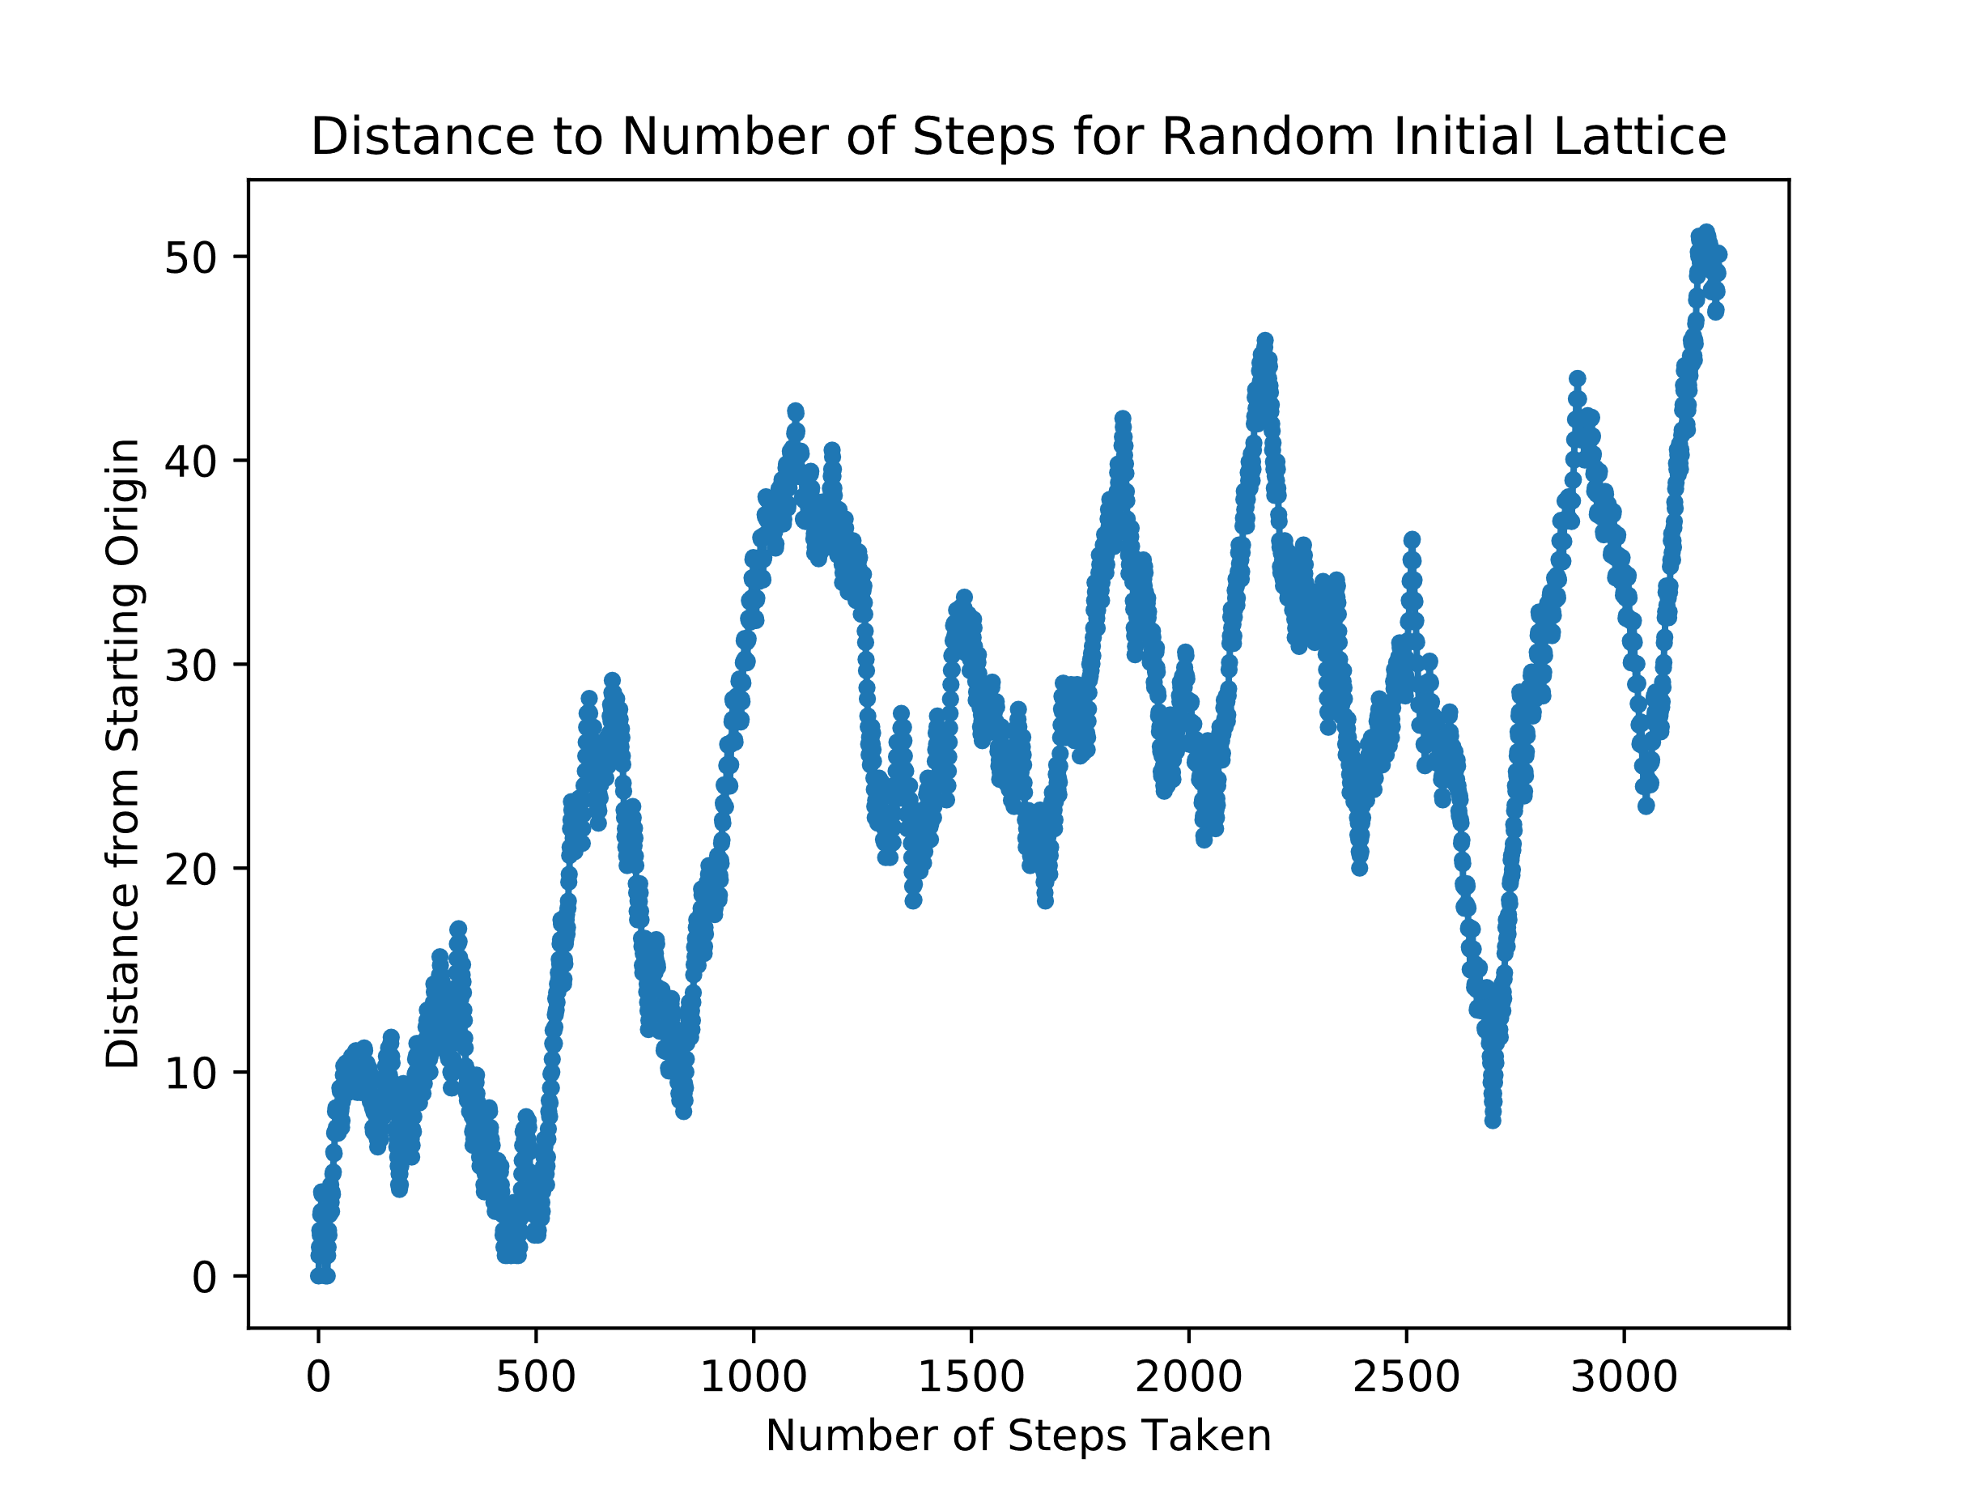
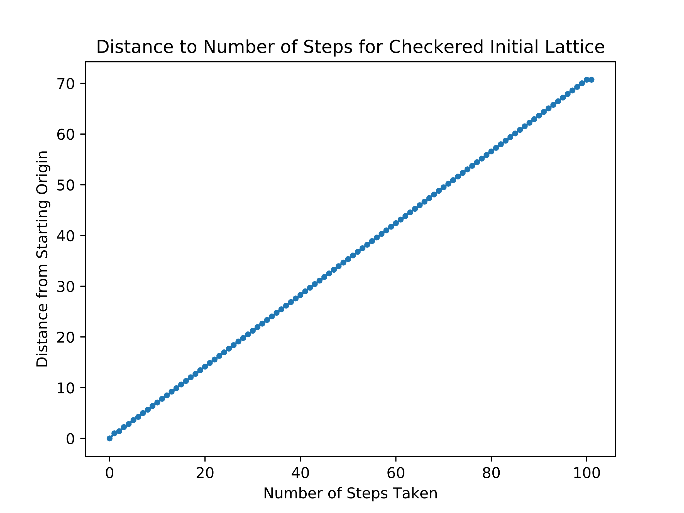
Langton’s Ant
Hope Lee
Introduction
Three Phases of Behavior Visualized
Turmites
Langton’s Ant is a variety of cellular automata, similar to Conway’s game of Life. The set-up and rules for Langton’s Ant’s basic algorithm is very straightforward. The simulation consists of a grid whose cells can be either black or white, with basic simulations starting with a fully white grid. An ant is then positioned at some initial starting location and its subsequent motion governed by two rules:
If at a white cell, turn 90 degrees right, flip the cell color, then move forward one cell
If at a black cell, turn 90 degrees left, flip the cell color, then move forward one cell
Demonstration of behavior of ant at a white cell:
Demonstration of behavior of ant at a black cell:
Randomness and Order in Initial Lattice
Phases of Behavior
Applications
Studies of artificial life and biochemistry
Image encryption and scrambling
Simulations of Lorentz lattice gas
As a Langton’s Ant system is allowed to evolve, three phases of behavior emerge:
Simplicity
Chaotic
Emergent Order
By the Cohen-Kong theorem, the final behavior of the ant will always be unbounded.
References

Slide 2
Notes:
A novel image encryption scheme using chaos and Langton’s Ant cellular automaton
Xingyuan Wang
Dahai Xu

